Slide 1


Boundless Lecture Slides
Available on the Boundless Teaching Platform
Free to share, print, make copies and changes. Get yours at www.boundless.com

Slide 2



Using Boundless Presentations
Boundless Teaching Platform
Boundless empowers educators to engage their students with affordable, customizable textbooks and intuitive teaching tools. The free Boundless Teaching Platform gives educators the ability to customize textbooks in more than 20 subjects that align to hundreds of popular titles. Get started by using high quality Boundless books, or make switching to our platform easier by building from Boundless content pre-organized to match the assigned textbook. This platform gives educators the tools they need to assign readings and assessments, monitor student activity, and lead their classes with pre-made teaching resources.
Get started now at:
The Appendix
The appendix is for you to use to add depth and breadth to your lectures. You can simply drag and drop slides from the appendix into the main presentation to make for a richer lecture experience.
http://boundless.com/teaching-platform
Free to edit, share, and copy
Feel free to edit, share, and make as many copies of the Boundless presentations as you like. We encourage you to take these presentations and make them your own.
If you have any questions or problems please email:
educators@boundless.com
Free to share, print, make copies and changes. Get yours at www.boundless.com

Slide 3

About Boundless
Boundless is an innovative technology company making education more affordable and accessible for students everywhere. The company creates the world’s best open educational content in 20+ subjects that align to more than 1,000 popular college textbooks. Boundless integrates learning technology into all its premium books to help students study more efficiently at a fraction of the cost of traditional textbooks. The company also empowers educators to engage their students more effectively through customizable books and intuitive teaching tools as part of the Boundless Teaching Platform. More than 2 million learners access Boundless free and premium content each month across the company’s wide distribution platforms, including its website, iOS apps, Kindle books, and iBooks. To get started learning or teaching with Boundless, visit boundless.com.
Free to share, print, make copies and changes. Get yours at www.boundless.com

Slide 4

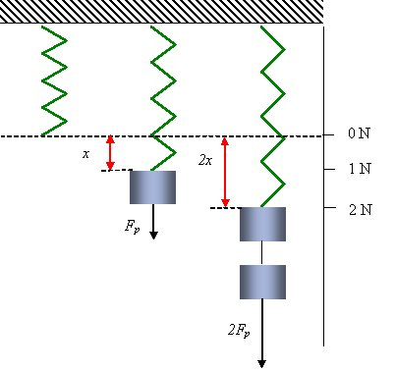
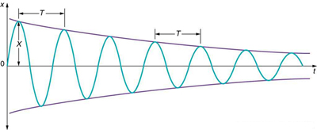
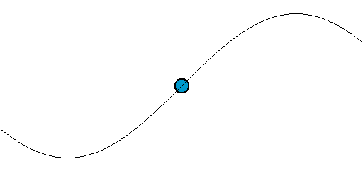
Waves and Vibrations
Introduction
Hooke's Law
Periodic Motion
Damped and Driven Oscillations
]
Waves
Waves and Vibrations
Free to share, print, make copies and changes. Get yours at www.boundless.com

Slide 5
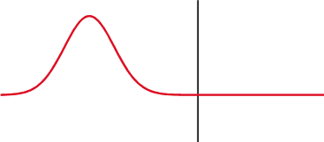
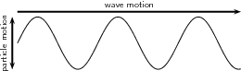
Waves and Vibrations (continued)
Wave Behavior and Interaction
Waves on Strings
]
Waves and Vibrations
Free to share, print, make copies and changes. Get yours at www.boundless.com

Slide 6

Introduction
Waves and Vibrations > Introduction
Position, Velocity, and Acceleration as a Function of Time
Free to share, print, make copies and changes. Get yours at www.boundless.com
www.boundless.com/physics/textbooks/boundless-physics-textbook/waves-and-vibrations-15/introduction-121/

Slide 7
Hooke's Law
Waves and Vibrations > Hooke's Law
Hooke's Law
Elastic Potential Energy
Free to share, print, make copies and changes. Get yours at www.boundless.com
www.boundless.com/physics/textbooks/boundless-physics-textbook/waves-and-vibrations-15/hooke-s-law-122/

Slide 8
Periodic Motion
Waves and Vibrations > Periodic Motion
Period and Frequency
Period of a Mass on a Spring
Simple Harmonic Motion
Simple Harmonic Motion and Uniform Circular Motion
The Simple Pendulum
The Physical Pendulum
Energy in a Simple Harmonic Oscillator
Sinusoidal Nature of Simple Harmonic Motion
Free to share, print, make copies and changes. Get yours at www.boundless.com
www.boundless.com/physics/textbooks/boundless-physics-textbook/waves-and-vibrations-15/periodic-motion-123/

Slide 9
Damped and Driven Oscillations
Waves and Vibrations > Damped and Driven Oscillations
Damped Harmonic Motion
Driven Oscillations and Resonance
Free to share, print, make copies and changes. Get yours at www.boundless.com
www.boundless.com/physics/textbooks/boundless-physics-textbook/waves-and-vibrations-15/damped-and-driven-oscillations-124/

Slide 10
Waves
Waves and Vibrations > Waves
Waves
Transverse Waves
Longitudinal Waves
Water Waves
Wavelength, Freqency in Relation to Speed
Energy Transportation
Free to share, print, make copies and changes. Get yours at www.boundless.com
www.boundless.com/physics/textbooks/boundless-physics-textbook/waves-and-vibrations-15/waves-125/

Slide 11
Wave Behavior and Interaction
Waves and Vibrations > Wave Behavior and Interaction
Reflection and Transmission
Superposition and Interference
Standing Waves and Resonance
Harmonic Wave Functions
Refraction
Diffraction
Mathematical Represenation of a Traveling Wave
Energy, Intensity, Frequency, and Amplitude
Free to share, print, make copies and changes. Get yours at www.boundless.com
www.boundless.com/physics/textbooks/boundless-physics-textbook/waves-and-vibrations-15/wave-behavior-and-interaction-126/

Slide 12
Waves on Strings
Waves and Vibrations > Waves on Strings
The Speed of a Wave on a String
Reflections
Free to share, print, make copies and changes. Get yours at www.boundless.com
www.boundless.com/physics/textbooks/boundless-physics-textbook/waves-and-vibrations-15/waves-on-strings-127/

Slide 13
Appendix
Free to share, print, make copies and changes. Get yours at www.boundless.com

Slide 14
Key terms
Waves and Vibrations
amplitude The maximum absolute value of some quantity that varies.
amplitude The maximum absolute value of some quantity that varies.
angular frequency The angular displacement per unit time.
boundary condition A set of restraints at the boundaries, used to solve a differential equation.
boundary condition A set of restraints at the boundaries, used to solve a differential equation.
centripetal acceleration Acceleration that makes a body follow a curved path: it is always perpendicular to the velocity of a body and directed towards the center of curvature of the path.
compression to increase in density; the act of compressing, or the state of being compressed; compaction
constructive interference Occurs when waves interfere with each other crest to crest and the waves are exactly in phase with each other.
crest The ridge or top of a wave.
Critically Damped "The condition in which the damping of an oscillator causes it to return as quickly as possible to its equilibrium position without oscillating back and forth about this position. "
deformation A transformation; change of shape.
destructive interference Occurs when waves interfere with each other crest to trough (peak to valley) and are exactly out of phase with each other.
Free to share, print, make copies and changes. Get yours at www.boundless.com

Slide 15
Waves and Vibrations
direction of propagation The axis along which the wave travels.
direction of propagation The axis along which the wave travels.
dissipative forces Forces that cause energy to be lost in a system undergoing motion.
elastic potential energy The energy stored in a deformable object, such as a spring.
elasticity The property by virtue of which a material deformed under the load can regain its original dimensions when unloaded
energy A quantity that denotes the ability to do work and is measured in a unit dimensioned in mass × distance²/time² (ML²/T²) or the equivalent.
equilibrium The state of a body at rest or in uniform motion, the resultant of all forces on which is zero.
force A physical quantity that denotes ability to push, pull, twist or accelerate a body which is measured in a unit dimensioned in mass × distance/time² (ML/T²): SI: newton (N); CGS: dyne (dyn)
Fourier analysis The study of the way general functions may be represented or approximated by sums of simpler trigonometric functions.
frequency The quotient of the number of times n a periodic phenomenon occurs over the time t in which it occurs: f = n / t.
frequency The quotient of the number of times n a periodic phenomenon occurs over the time t in which it occurs: f = n / t.
group velocity The propagation velocity of the envelope of a modulated travelling wave, which is considered as the propagation velocity of information or energy contained in it.
Free to share, print, make copies and changes. Get yours at www.boundless.com

Slide 16
Waves and Vibrations
interference An effect caused by the superposition of two systems of waves, such as a distortion on a broadcast signal due to atmospheric or other effects.
interference An effect caused by the superposition of two systems of waves, such as a distortion on a broadcast signal due to atmospheric or other effects.
kinetic energy The energy possessed by an object because of its motion, equal to one half the mass of the body times the square of its velocity.
Longitudinal Running in the direction of the long axis of a body.
mass distribution Describes the spatial distribution, and defines the center, of mass in an object.
medium The material or empty space through which signals, waves or forces pass.
oscillate To swing back and forth, especially if with a regular rhythm.
oscillating Moving in a repeated back-and-forth motion.
oscillator A pattern that returns to its original state, in the same orientation and position, after a finite number of generations.
oscillator A pattern that returns to its original state, in the same orientation and position, after a finite number of generations.
Over Damped "The condition in which damping of an oscillator causes it to return to equilibrium without oscillating; oscillator moves more slowly toward equilibrium than in the critically damped system. "
period The duration of one cycle in a repeating event.
Free to share, print, make copies and changes. Get yours at www.boundless.com

Slide 17
Waves and Vibrations
phase velocity The velocity of propagation of a pure sine wave of infinite extent and infinitesimal amplitude.
photoelectric effects In photoelectric effects, electrons are emitted from matter (metals and non-metallic solids, liquids or gases) as a consequence of their absorption of energy from electromagnetic radiation.
physical pendulum A pendulum where the rod or string is not massless, and may have extended size; that is, an arbitrarily-shaped, rigid body swinging by a pivot. In this case, the pendulum's period depends on its moment of inertia around the pivot point.
plane wave A constant-frequency wave whose wavefronts (surfaces of constant phase) are infinite parallel planes of constant peak-to-peak amplitude normal to the phase velocity vector.
power A measure of the rate of doing work or transferring energy.
rarefaction a reduction in the density of a material, especially that of a fluid
refractive index The ratio of the speed of light in air or vacuum to that in another medium.
resonance The increase in the amplitude of an oscillation of a system under the influence of a periodic force whose frequency is close to that of the system's natural frequency.
Restoring force A variable force that gives rise to an equilibrium in a physical system. If the system is perturbed away from the equilibrium, the restoring force will tend to bring the system back toward equilibrium. The restoring force is a function only of position of the mass or particle. It is always directed back toward the equilibrium position of the system
Restoring force If the system is perturbed away from the equilibrium, the restoring force will tend to bring the system back toward equilibrium. The restoring force is a function only of position of the mass or particle. It is always directed back toward the equilibrium position of the system.An example is the action of a spring. An idealized spring exerts a force that is proportional to the amount of deformation of the spring from its equilibrium length, exerted in a direction to oppose the deformation. Pulling the spring to a greater length causes it to exert a force that brings the spring back toward its equilibrium length. The amount of force can be determined by multiplying the spring constant of the spring by the amount of stretch.
simple harmonic motion (SHM) — Oscillating motion (as of a pendulum) in which the acceleration of the oscillator has an equal magnitude but opposite direction to the displacement of it from the equilibrium position.
simple harmonic oscillator A device that implements Hooke's law, such as a mass that is attached to a spring, with the other end of the spring being connected to a rigid support, such as a wall.
Free to share, print, make copies and changes. Get yours at www.boundless.com

Slide 18
Waves and Vibrations
simple pendulum A hypothetical pendulum consisting of a weight suspended by a weightless string.
sinusoidal In the form of a wave, especially one whose amplitude varies in proportion to the sine of some variable (such as time).
Snell's law A formula used to describe the relationship between the angles of incidence and refraction.
speed of propagation The speed at which a wave moves through a medium.
standing wave A wave form which occurs in a limited, fixed medium in such a way that the reflected wave coincides with the produced wave. A common example is the vibration of the strings on a musical stringed instrument.
superposition The summing of two or more field contributions occupying the same space.
superposition The summing of two or more field contributions occupying the same space.
transverse wave Any wave in which the direction of disturbance is perpendicular to the direction of travel.
transverse wave Any wave in which the direction of disturbance is perpendicular to the direction of travel.
transverse wave Any wave in which the direction of disturbance is perpendicular to the direction of travel.
trough A long, narrow depression between waves or ridges.
ultrasound Sound with a frequency greater than the upper limit of human hearing; approximately 20 kilohertz.
Free to share, print, make copies and changes. Get yours at www.boundless.com

Slide 19
Waves and Vibrations
Under Damped "The condition in which damping of an oscillator causes it to return to equilibrium with the amplitude gradually decreasing to zero; system returns to equilibrium faster but overshoots and crosses the equilibrium position one or more times. "
uniform circular motion Movement around a circular path with constant speed.
wave A moving disturbance in the energy level of a field.
wave equation An important second-order linear partial differential equation for the description of waves such as sound waves, light waves, and water waves.
wave speed The absolute value of the velocity at which the phase of any one frequency component of the wave travels.
waveform The shape of a physical wave, such as sound or electromagnetic radiation. The shape can be any function that repeats in space.
wavelength The length of a single cycle of a wave, as measured by the distance between one peak or trough of a wave and the next; it is often designated in physics as λ, and corresponds to the velocity of the wave divided by its frequency.
wavelength The length of a single cycle of a wave, as measured by the distance between one peak or trough of a wave and the next; it is often designated in physics as λ, and corresponds to the velocity of the wave divided by its frequency.
work A measure of energy expended in moving an object; most commonly, force times displacement. No work is done if the object does not move.
Free to share, print, make copies and changes. Get yours at www.boundless.com

Slide 20
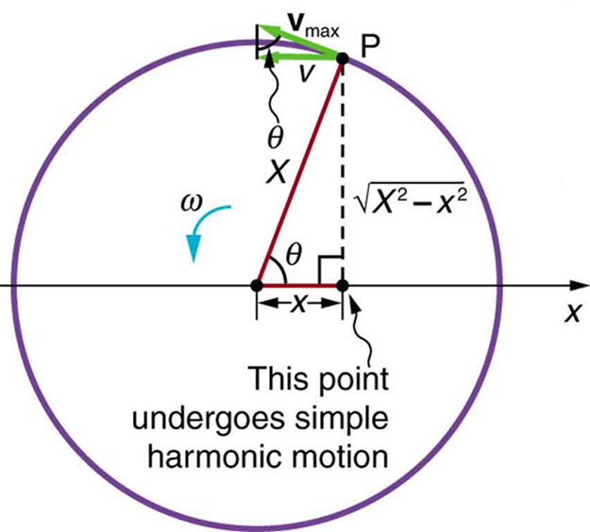

Waves and Vibrations
Projection of Uniform Circular Motion
A point P moving on a circular path with a constant angular velocity ω is undergoing uniform circular motion. Its projection on the x-axis undergoes simple harmonic motion. Also shown is the velocity of this point around the circle, v−max, and its projection, which is v. Note that these velocities form a similar triangle to the displacement triangle.
Free to share, print, make copies and changes. Get yours at www.boundless.com
OpenStax CNX. "OpenStax College, College Physics. October 7, 2012." CC BY 3.0 http://cnx.org/content/m42245/latest/?collection=col11406/1.7 View on Boundless.com

Slide 21
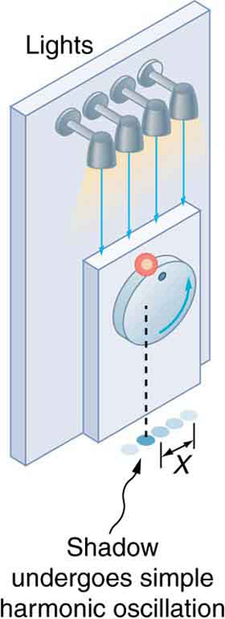
Waves and Vibrations
Shadow of a Ball Undergoing Simple Harmonic Motion
The shadow of a ball rotating at constant angular velocity ω on a turntable goes back and forth in precise simple harmonic motion.
Free to share, print, make copies and changes. Get yours at www.boundless.com
OpenStax CNX. "OpenStax College, College Physics. October 7, 2012." CC BY 3.0 http://cnx.org/content/m42245/latest/?collection=col11406/1.7 View on Boundless.com

Slide 22
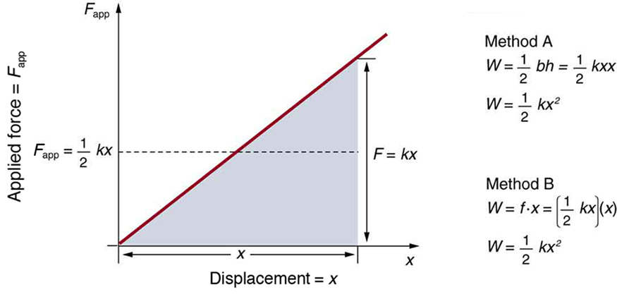
Waves and Vibrations
Applied force versus deformation
A graph of applied force versus distance for the deformation of a system that can be described by Hooke's law is displayed. The work done on the system equals the area under the graph or the area of the triangle, which is half its base multiplied by its height, or .
Free to share, print, make copies and changes. Get yours at www.boundless.com
OpenStax CNX. "OpenStax College, College Physics. November 3, 2012." CC BY 3.0 http://cnx.org/content/m42240/latest/?collection=col11406/1.7 View on Boundless.com

Slide 23
Waves and Vibrations
Transverse Wave
Diagram of a transverse wave. The wave motion moves perpendicular to the medium it is traveling in.
Free to share, print, make copies and changes. Get yours at www.boundless.com
OpenStax CNX. "Rory Adams (Free High School Science Texts Project), Mark Horner, and Heather Williams, Transverse Waves - Grade 10. January 24, 2013." CC BY 3.0 http://cnx.org/content/m32635/latest/ View on Boundless.com

Slide 24
Waves and Vibrations
Figure 1
In transverse waves, the media the wave is traveling in moves perpendicular to the direction of the wave.
Free to share, print, make copies and changes. Get yours at www.boundless.com
OpenStax CNX. "Rory Adams (Free High School Science Texts Project), Mark Horner, and Heather Williams, Transverse Waves - Grade 10. January 24, 2013." CC BY 3.0 http://cnx.org/content/m32635/latest/ View on Boundless.com

Slide 25
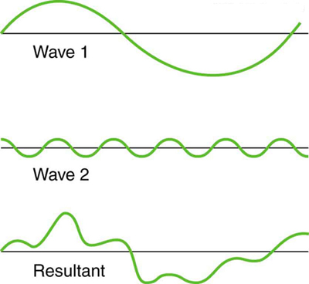
Waves and Vibrations
Superposition of Non-Identical Waves
Superposition of non-identical waves exhibits both constructive and destructive interference.
Free to share, print, make copies and changes. Get yours at www.boundless.com
OpenStax CNX. "OpenStax College, Superposition and Interference. February 6, 2013." CC BY 3.0 http://cnx.org/content/m42249/latest/ View on Boundless.com

Slide 26
Waves and Vibrations
Sinusoidal Waves of Varying Frequencies
Sinusoidal waves of various frequencies; the bottom waves have higher frequencies than those above. The horizontal axis represents time.
Free to share, print, make copies and changes. Get yours at www.boundless.com
Wikipedia. "Sine waves different frequencies." Public domain http://en.wikipedia.org/wiki/File:Sine_waves_different_frequencies.svg View on Boundless.com

Slide 27
Waves and Vibrations
Common waveforms
A sample of several common, simple waveforms. A waveform is a function that repeats in space.
Free to share, print, make copies and changes. Get yours at www.boundless.com
Wikipedia. "File:Waveforms.svg - Wikipedia, the free encyclopedia." CC BY-SA http://en.wikipedia.org/w/index.php?title=File:Waveforms.svg&page=1 View on Boundless.com

Slide 28

Waves and Vibrations
Complex Pattern of Waves
These waves result from the superposition of several waves from different sources, producing a complex pattern.
Free to share, print, make copies and changes. Get yours at www.boundless.com
OpenStax CNX. "OpenStax College, Superposition and Interference. February 6, 2013." CC BY 3.0 http://cnx.org/content/m42249/latest/ View on Boundless.com

Slide 29
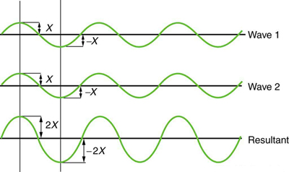
Waves and Vibrations
Constructive Interference
Pure constructive interference of two identical waves produces one with twice the amplitude, but the same wavelength.
Free to share, print, make copies and changes. Get yours at www.boundless.com
OpenStax CNX. "OpenStax College, Superposition and Interference. February 6, 2013." CC BY 3.0 http://cnx.org/content/m42249/latest/ View on Boundless.com

Slide 30
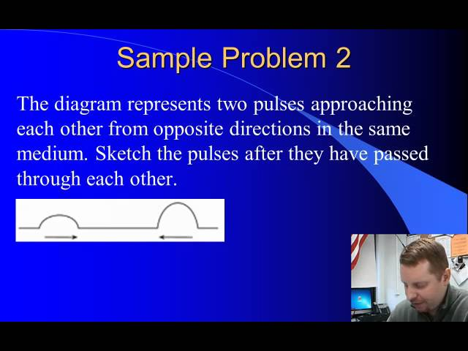
Waves and Vibrations
Wave Interference
A brief introduction to constructive and destructive wave interference and the principle of superposition.
Free to share, print, make copies and changes. Get yours at www.boundless.com
View on Boundless.com

Slide 31
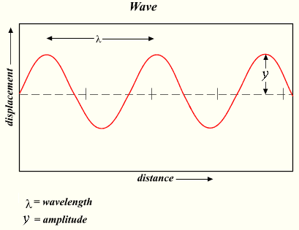
Waves and Vibrations
Wavelength and Amplitude
The wavelength is the distance between adjacent crests. The amplitude is the 1/2 the distance from crest to trough.
Free to share, print, make copies and changes. Get yours at www.boundless.com
Wikipedia. "Wave." GNU FDL http://simple.wikipedia.org/wiki/File:Wave.png View on Boundless.com

Slide 32
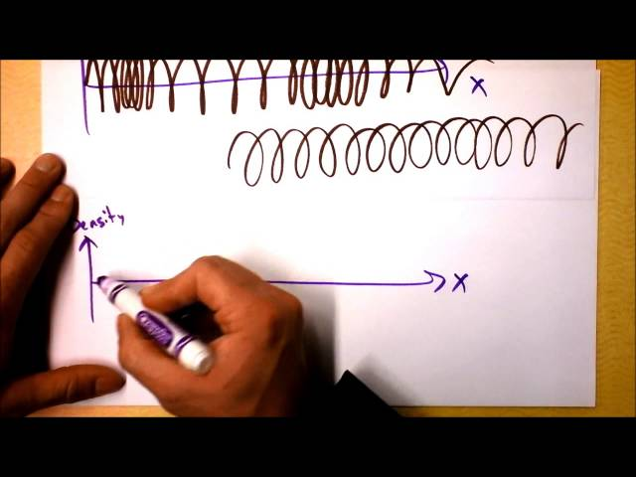
Waves and Vibrations
Two Types of Waves: Longitudinal vs. Transverse
Even ocean waves!
Free to share, print, make copies and changes. Get yours at www.boundless.com
View on Boundless.com

Slide 33
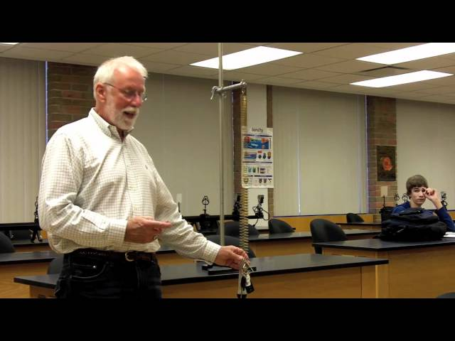
Waves and Vibrations
Experience with a simple harmonic oscillator
A known mass is hung from a spring of known spring constant and allowed to oscillate. The time for one oscillation (period) is measured. This value is compared to a predicted value, based on the mass and spring constant.
Free to share, print, make copies and changes. Get yours at www.boundless.com
View on Boundless.com

Slide 34
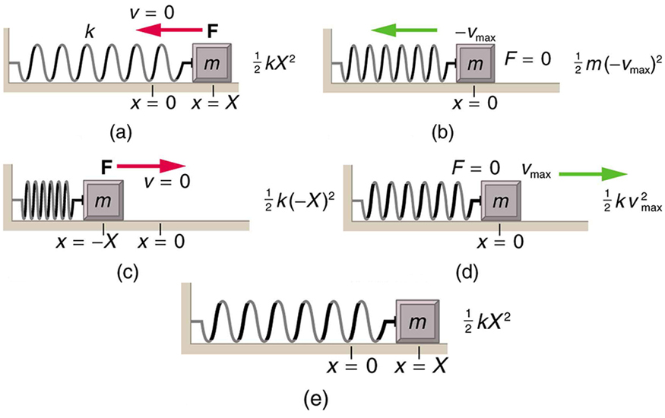
Waves and Vibrations
Energy in a Simple Harmonic Oscillator
The transformation of energy in simple harmonic motion is illustrated for an object attached to a spring on a frictionless surface. (a) The mass has achieved maximum displacement from equilibrium. All energy is potential energy. (b) As the mass passes through the equilibrium point with maximum speed all energy in the system is in kinetic energy. (c) Once again, all energy is in the potential form, stored in the compression of the spring (in the first panel the energy was stored in the extension of the spring). (d) Passing through equilibrium again all energy is kinetic. (e) The mass has completed an entire cycle.
Free to share, print, make copies and changes. Get yours at www.boundless.com
OpenStax CNX. "OpenStax College, College Physics. October 8, 2012." CC BY 3.0 http://cnx.org/content/m42244/latest/?collection=col11406/1.7 View on Boundless.com

Slide 35
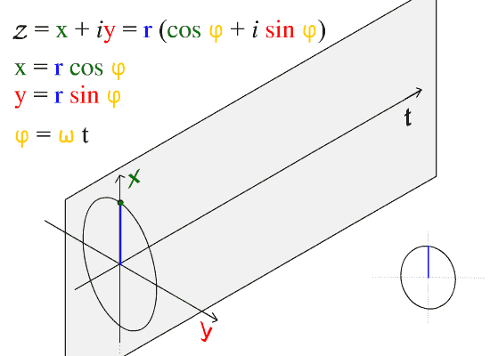
Waves and Vibrations
Sine Wave
The direction of propagation of this wave is along the t axis.
Free to share, print, make copies and changes. Get yours at www.boundless.com
Wikipedia. "ComplexSinInATimeAxe." Public domain http://en.wikipedia.org/wiki/File:ComplexSinInATimeAxe.gif View on Boundless.com

Slide 36
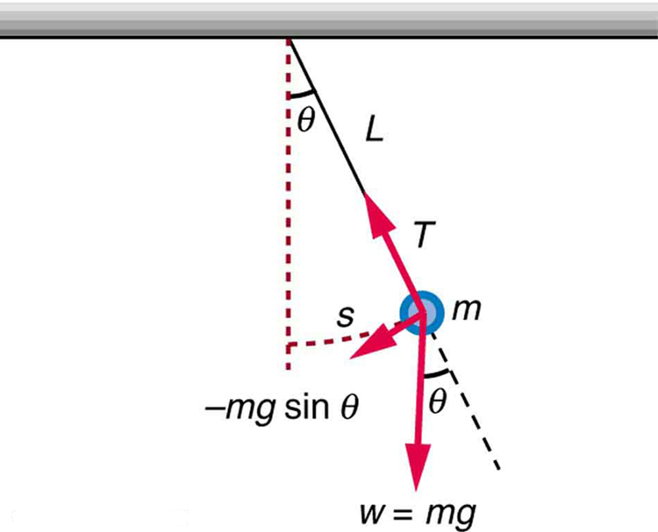
Waves and Vibrations
Simple Pendulum
A simple pendulum has a small-diameter bob and a string that has a very small mass but is strong enough not to stretch appreciably. The linear displacement from equilibrium is s, the length of the arc. Also shown are the forces on the bob, which result in a net force of −mgsinθ toward the equilibrium position—that is, a restoring force.
Free to share, print, make copies and changes. Get yours at www.boundless.com
OpenStax CNX. "OpenStax College, College Physics. October 8, 2012." CC BY 3.0 http://cnx.org/content/m42243/latest/?collection=col11406/1.7 View on Boundless.com

Slide 37
Waves and Vibrations
Wave motion
The point along the axis is analogous to the floating ball at sea. We notice that while it moves up and down it does not move in the direction of the wave's propagation.
Free to share, print, make copies and changes. Get yours at www.boundless.com
Wikipedia. "Simple harmonic motion animation." Public domain http://en.wikipedia.org/wiki/File:Simple_harmonic_motion_animation.gif View on Boundless.com

Slide 38
Waves and Vibrations
Refraction in Water
An object (in this case a pencil) partially immersed in water looks bent due to refraction: the light waves from X change direction and so seem to originate at Y. (More accurately, for any angle of view, Y should be vertically above X, and the pencil should appear shorter, not longer as shown. )
Free to share, print, make copies and changes. Get yours at www.boundless.com
Wikipedia. "Refraction." CC BY http://en.wikipedia.org/wiki/Refraction View on Boundless.com

Slide 39

Waves and Vibrations
Water Wave
Waves that are more massive or have a greater velocity transport more energy.
Free to share, print, make copies and changes. Get yours at www.boundless.com
Wikipedia. "Waves in pacifica 1." GNU FDL http://en.wikipedia.org/wiki/File:Waves_in_pacifica_1.jpg View on Boundless.com

Slide 40
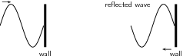
Waves and Vibrations
Transverse Wave With a Fixed End Point
A transverse wave that is fixed at the end point. The reflected wave is inverted.
Free to share, print, make copies and changes. Get yours at www.boundless.com
OpenStax CNX. "Rory Adams (Free High School Science Texts Project), Mark Horner, and Heather Williams, Transverse Waves - Grade 10. January 24, 2013." CC BY 3.0 http://cnx.org/content/m32635/latest/ View on Boundless.com

Slide 41
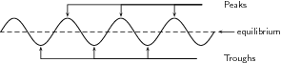
Waves and Vibrations
Figure 2
Peaks are the top most points of the waves and troughs are the bottom, or valleys of the waves.
Free to share, print, make copies and changes. Get yours at www.boundless.com
OpenStax CNX. "Rory Adams (Free High School Science Texts Project), Mark Horner, and Heather Williams, Transverse Waves - Grade 10. January 24, 2013." CC BY 3.0 http://cnx.org/content/m32635/latest/ View on Boundless.com

Slide 42
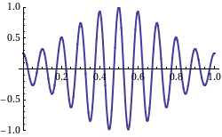
Waves and Vibrations
Fig 2
This shows a wave with the group velocity and phase velocity going in different directions. (The group velocity is positive and the phase velocity is negative. )
Free to share, print, make copies and changes. Get yours at www.boundless.com
Wikipedia. "Group velocity." CC BY http://en.wikipedia.org/wiki/Group_velocity View on Boundless.com

Slide 43

Waves and Vibrations
Water waves
Surface waves in water
Free to share, print, make copies and changes. Get yours at www.boundless.com
Wikipedia. "Wave." CC BY http://en.wikipedia.org/wiki/Wave View on Boundless.com

Slide 44
Waves and Vibrations
Partial Transmittance and Partial Reflectance
A wave experiences partial transmittance and partial reflectance when the medium through which it travels suddenly changes.
Free to share, print, make copies and changes. Get yours at www.boundless.com
Wikipedia. "Transmission (wave propagation)." CC BY http://en.wikipedia.org/wiki/Transmission_(wave_propagation) View on Boundless.com

Slide 45
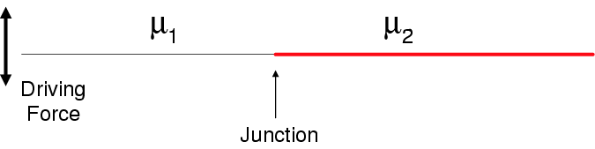
Waves and Vibrations
Two Strings With Different Density
Two strings with different density are connected and driven by an external driving force.
Free to share, print, make copies and changes. Get yours at www.boundless.com
OpenStax CNX. "Paul Padley, Reflection and Transmission of Mechanical Waves. February 6, 2013." CC BY 3.0 http://cnx.org/content/m12794/latest/ View on Boundless.com

Slide 46
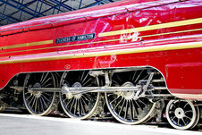
Waves and Vibrations
Locomotive Wheels
The locomotive's wheels spin at a frequency of f cycles per second, which can also be described as ω radians per second. The mechanical linkages allow the linear vibration of the steam engine's pistons, at frequency f, to drive the wheels.
Free to share, print, make copies and changes. Get yours at www.boundless.com
Light and Matter. CC BY-SA http://lightandmatter.com/html_books/me/ch16/figs/locomotive-linkages.jpg View on Boundless.com

Slide 47
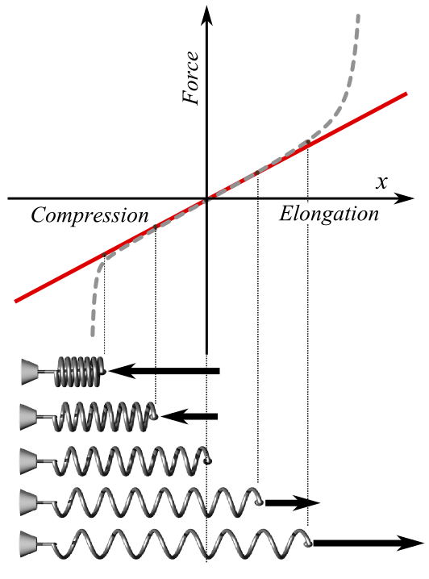
Waves and Vibrations
Hooke's Law
The red line in this graph illustrates how force, F, varies with position according to Hooke's law. The slope of this line corresponds to the spring constant k. The dotted line shows what the actual (experimental) plot of force might look like. The pictures of spring states at the bottom of the graph correspond to some points of the plot; the middle one is in the relaxed state (no force applied).
Free to share, print, make copies and changes. Get yours at www.boundless.com
Wikipedia. "HookesLawForSpring-English.png." CC BY-SA 4.0 https://upload.wikimedia.org/wikipedia/commons/f/f0/HookesLawForSpring-English.png View on Boundless.com

Slide 48
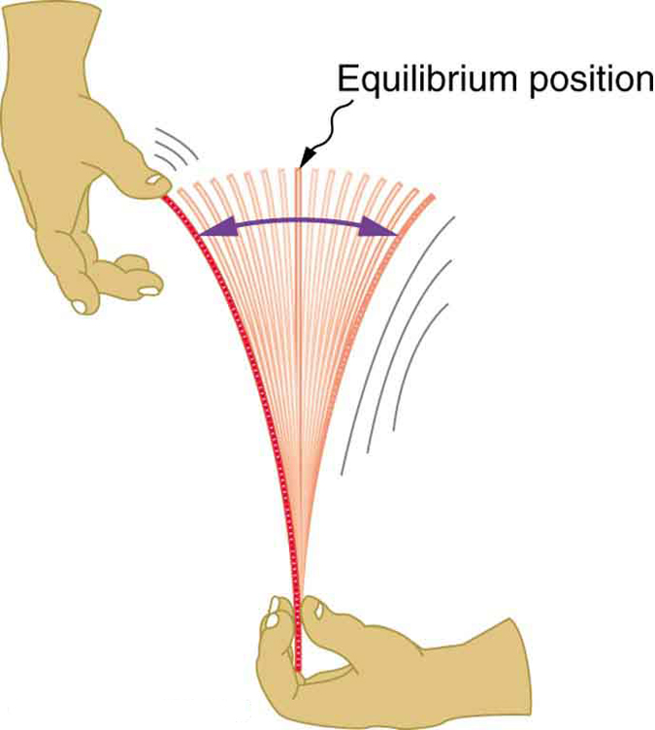
Waves and Vibrations
Oscillating Ruler
When displaced from its vertical equilibrium position, this plastic ruler oscillates back and forth because of the restoring force opposing displacement. When the ruler is on the left, there is a force to the right, and vice versa.
Free to share, print, make copies and changes. Get yours at www.boundless.com
OpenStax CNX. "OpenStax College, College Physics. October 6, 2012." CC BY 3.0 http://cnx.org/content/m42240/latest/?collection=col11406/1.7 View on Boundless.com

Slide 49
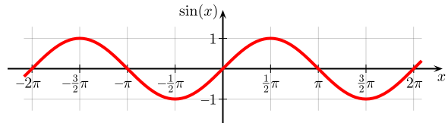
Waves and Vibrations
Plot of Sine
The sine function graphed on the Cartesian plane. In this graph, the angle x is given in radians (π = 180°).
Free to share, print, make copies and changes. Get yours at www.boundless.com
Wikipedia. "Plot of Sine." CC BY-SA 4.0 https://upload.wikimedia.org/wikipedia/commons/a/a2/Sine.svg View on Boundless.com

Slide 50
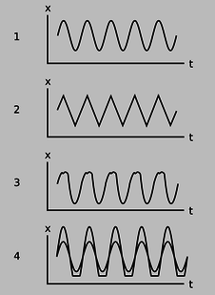
Waves and Vibrations
Sinusoidal and Non-Sinusoidal Vibrations
Only the top graph is sinusoidal. The others vary with constant amplitude and period, but do no describe simple harmonic motion.
Free to share, print, make copies and changes. Get yours at www.boundless.com
Light and Matter. "Vibrations." CC BY-SA http://lightandmatter.com/html_books/me/ch16/ch16.html View on Boundless.com

Slide 51
Waves and Vibrations
Standing Waves
Standing waves in a string, the fundamental mode and the first six overtones.
Free to share, print, make copies and changes. Get yours at www.boundless.com
Wikipedia. "Standing wave." CC BY http://en.wikipedia.org/wiki/Standing_wave View on Boundless.com

Slide 52
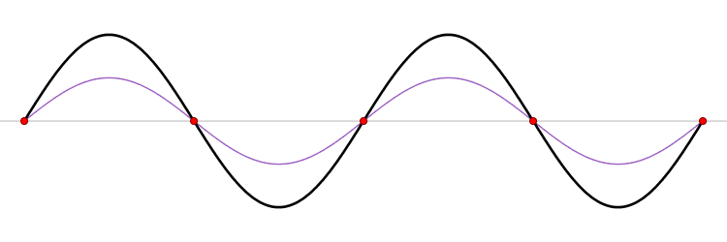
Waves and Vibrations
Standing Wave
A standing wave (black) depicted as the sum of two propagating waves traveling in opposite directions (red and blue).
Free to share, print, make copies and changes. Get yours at www.boundless.com
Wikipedia. "Standing wave." CC BY http://en.wikipedia.org/wiki/Standing_wave View on Boundless.com

Slide 53

Waves and Vibrations
Intensity Pattern
Intensity pattern formed on a screen by diffraction from a square aperture.
Free to share, print, make copies and changes. Get yours at www.boundless.com
Wikipedia. "Diffraction." CC BY http://en.wikipedia.org/wiki/Diffraction View on Boundless.com

Slide 54
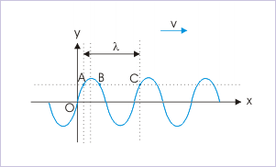
Waves and Vibrations
Harmonic Waves
Harmonic waves are described by sinusoidal functions. The wavelength is equal to linear distance between repetitions of transverse disturbance or phase.
Free to share, print, make copies and changes. Get yours at www.boundless.com
OpenStax CNX. "Sunil Kumar Singh, Transverse Harmonic Waves. February 6, 2013." CC BY 3.0 http://cnx.org/content/m15992/latest/ View on Boundless.com

Slide 55
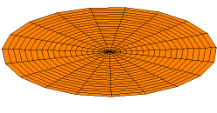
Waves and Vibrations
Wave Equation in Two Dimensions
A solution of the wave equation in two dimensions with a zero-displacement boundary condition along the entire outer edge.
Free to share, print, make copies and changes. Get yours at www.boundless.com
Wikipedia. "Wave equation." CC BY http://en.wikipedia.org/wiki/Wave_equation View on Boundless.com

Slide 56
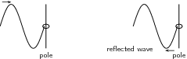
Waves and Vibrations
Transverse Wave With a Free End
When a transverse wave meets a free end, it is reflected.
Free to share, print, make copies and changes. Get yours at www.boundless.com
OpenStax CNX. "Rory Adams (Free High School Science Texts Project), Mark Horner, and Heather Williams, Transverse Waves - Grade 10. January 24, 2013." CC BY 3.0 http://cnx.org/content/m32635/latest/ View on Boundless.com

Slide 57
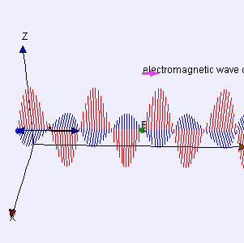
Waves and Vibrations
Electromagnetic Wave
Electromagnetic waves can be imagined as a self-propagating transverse oscillating wave of electric and magnetic fields. This 3D diagram shows a plane linearly polarized wave propagating from left to right.
Free to share, print, make copies and changes. Get yours at www.boundless.com
Wikipedia. "Electromagneticwave3Dfromside." CC BY http://en.wikipedia.org/wiki/File:Electromagneticwave3Dfromside.gif View on Boundless.com

Slide 58
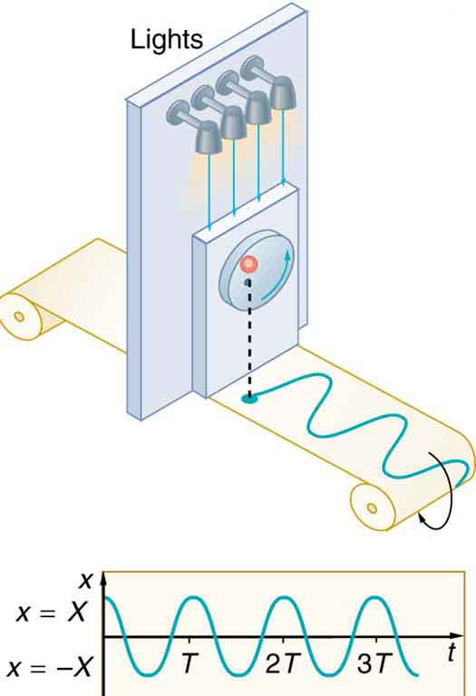
Waves and Vibrations
Sinusoidal Nature of Uniform Circular Motion
The position of the projection of uniform circular motion performs simple harmonic motion, as this wavelike graph of x versus t indicates.
Free to share, print, make copies and changes. Get yours at www.boundless.com
OpenStax CNX. "OpenStax College, College Physics. October 8, 2012." CC BY 3.0 http://cnx.org/content/m42245/latest/?collection=col11406/1.7 View on Boundless.com

Slide 59
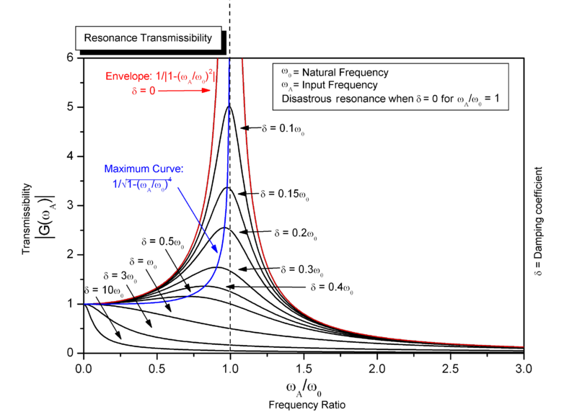
Waves and Vibrations
Resonance
Steady state variation of amplitude with frequency and damping of a driven simple harmonic oscillator.
Free to share, print, make copies and changes. Get yours at www.boundless.com
Wikimedia. CC BY-SA http://upload.wikimedia.org/wikipedia/commons/thumb/0/07/Resonance.PNG/800px-Resonance.PNG View on Boundless.com

Slide 60
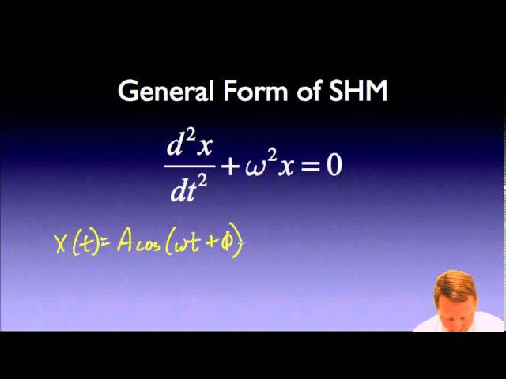
Waves and Vibrations
Simple Harmonic Motion
A brief introduction to simple harmonic motion for calculus-based physics students.
Free to share, print, make copies and changes. Get yours at www.boundless.com
View on Boundless.com

Slide 61
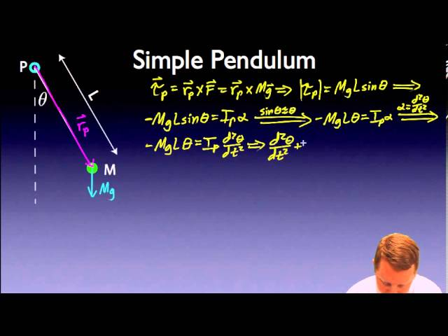
Waves and Vibrations
Pendulums
A brief introduction to pendulums (both ideal and physical) for calculus-based physics students from the standpoint of simple harmonic motion.
Free to share, print, make copies and changes. Get yours at www.boundless.com
View on Boundless.com

Slide 62
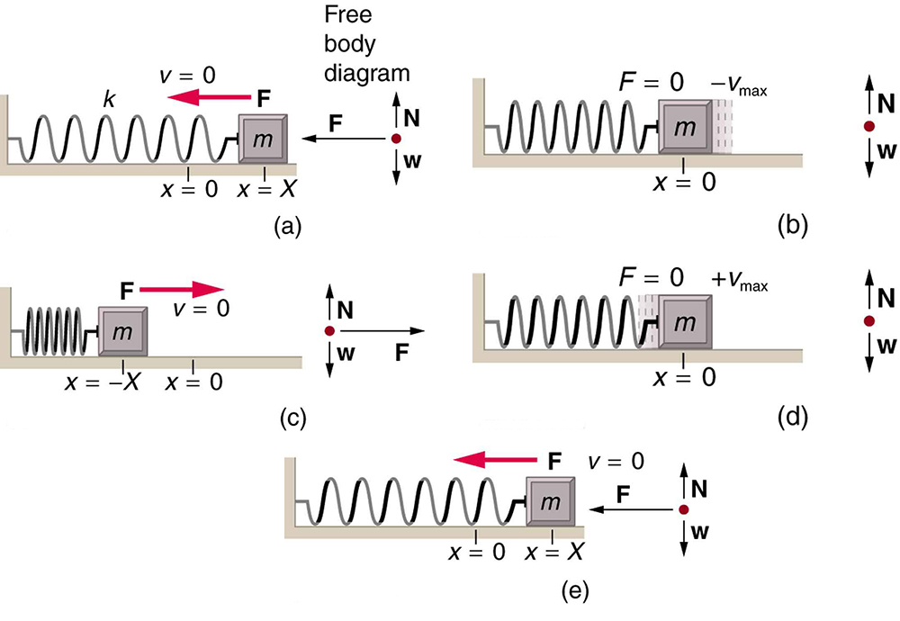
Waves and Vibrations
Motion of a mass on an ideal spring
An object attached to a spring sliding on a frictionless surface is an uncomplicated simple harmonic oscillator. When displaced from equilibrium, the object performs simple harmonic motion that has an amplitude X and a period T. The object's maximum speed occurs as it passes through equilibrium. The stiffer the spring is, the smaller the period T. The greater the mass of the object is, the greater the period T. (a) The mass has achieved its greatest displacement X to the right and now the restoring force to the left is at its maximum magnitude. (b) The restoring force has moved the mass back to its equilibrium point and is now equal to zero, but the leftward velocity is at its maximum. (c) The mass's momentum has carried it to its maximum displacement to the right. The restoring force is now to the right, equal in magnitude and opposite in direction compared to (a). (d) The equilibrium point is reach again, this time with momentum to the right. (e) The cycle repeats.
Free to share, print, make copies and changes. Get yours at www.boundless.com
OpenStax CNX. "OpenStax College, College Physics. October 7, 2012." CC BY 3.0 http://cnx.org/content/m42242/latest/?collection=col11406/1.7 View on Boundless.com

Slide 63
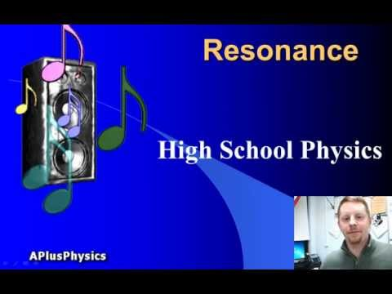
Waves and Vibrations
Resonance
A brief overview of resonance, targeted toward introductory physics students.
Free to share, print, make copies and changes. Get yours at www.boundless.com
View on Boundless.com

Slide 64

Waves and Vibrations
Earthquake Destruction
The destructive effect of an earthquake is palpable evidence of the energy carried in these waves. The Richter scale rating of earthquakes is related to both their amplitude and the energy they carry.
Free to share, print, make copies and changes. Get yours at www.boundless.com
OpenStax CNX. "OpenStax College, College Physics. February 7, 2013." CC BY 3.0 http://cnx.org/content/m42250/latest/?collection=col11406/1.7 View on Boundless.com

Slide 65
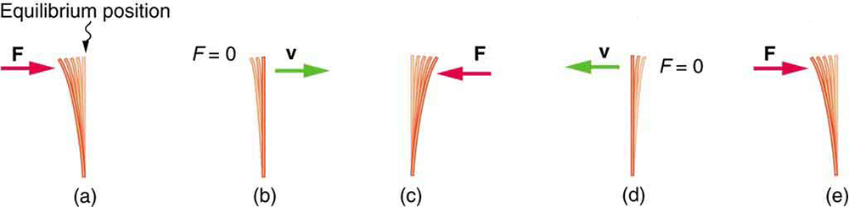
Waves and Vibrations
Restoring force, momentum, and equilibrium
(a) The plastic ruler has been released, and the restoring force is returning the ruler to its equilibrium position. (b) The net force is zero at the equilibrium position, but the ruler has momentum and continues to move to the right. (c) The restoring force is in the opposite direction. It stops the ruler and moves it back toward equilibrium again. (d) Now the ruler has momentum to the left. (e) In the absence of damping (caused by frictional forces), the ruler reaches its original position. From there, the motion will repeat itself.
Free to share, print, make copies and changes. Get yours at www.boundless.com
OpenStax CNX. "OpenStax College, College Physics. October 6, 2012." CC BY 3.0 http://cnx.org/content/m42240/latest/?collection=col11406/1.7 View on Boundless.com

Slide 66
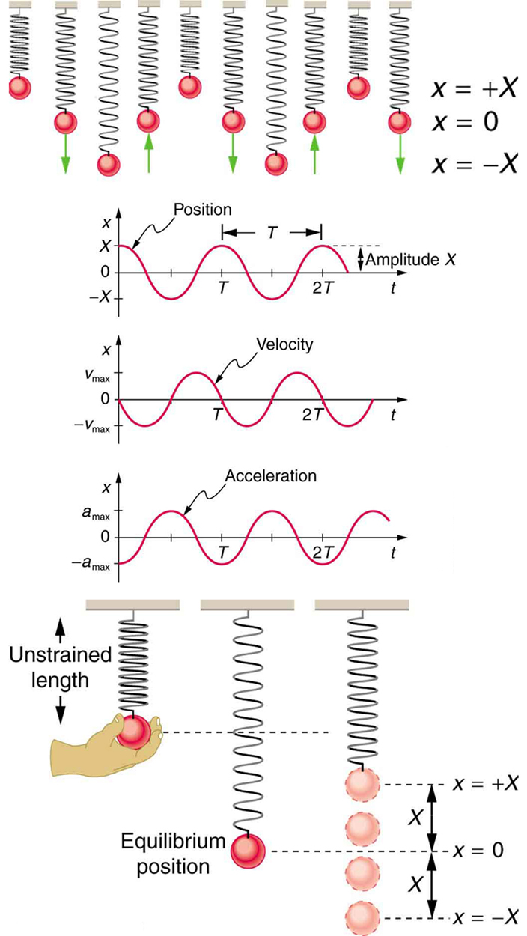
Waves and Vibrations
Visualizing Simple Harmonic Motion
Graphs of x(t),v(t), and a(t) versus t for the motion of an object on a spring. The net force on the object can be described by Hooke's law, and so the object undergoes simple harmonic motion. Note that the initial position has the vertical displacement at its maximum value X; v is initially zero and then negative as the object moves down; and the initial acceleration is negative, back toward the equilibrium position and becoming zero at that point.
Free to share, print, make copies and changes. Get yours at www.boundless.com
OpenStax CNX. "OpenStax College, College Physics. October 7, 2012." CC BY 3.0 http://cnx.org/content/m42242/latest/?collection=col11406/1.7 View on Boundless.com

Slide 67
Waves and Vibrations
Uniform Circular Motion (at Four Different Point in the Orbit)
Velocity v and acceleration a in uniform circular motion at angular rate ω; the speed is constant, but the velocity is always tangent to the orbit; the acceleration has constant magnitude, but always points toward the center of rotation
Free to share, print, make copies and changes. Get yours at www.boundless.com
Wikipedia. "Uniform circular motion." GNU FDL http://en.wikipedia.org/wiki/Uniform_circular_motion View on Boundless.com

Slide 68
Waves and Vibrations
Diagram of Hooke's Law
The extension of the spring is linearly proportional to the force.
Free to share, print, make copies and changes. Get yours at www.boundless.com
Wikimedia. "Dinamometro." CC BY-SA http://commons.wikimedia.org/wiki/File:Dinamometro.jpg View on Boundless.com

Slide 69
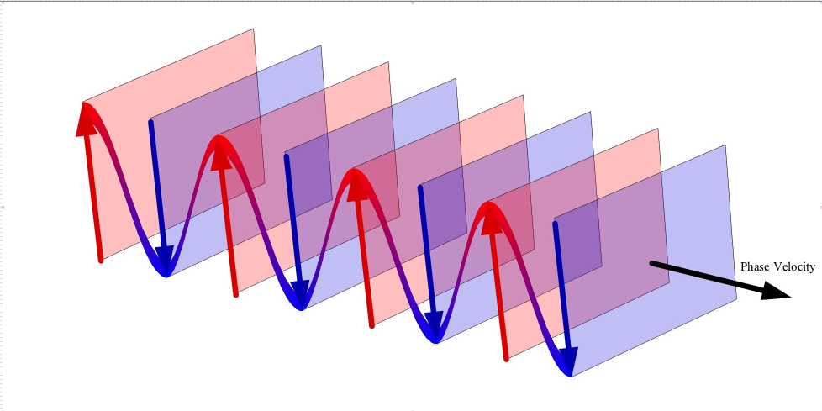
Waves and Vibrations
Plane wave
We see a wave propagating in the direction of the phase velocity. The wave can be thought to be made up of planes orthogonal to the direction of the phase velocity.
Free to share, print, make copies and changes. Get yours at www.boundless.com
Wikimedia. "Plane Wave Oblique View." Public domain http://commons.wikimedia.org/wiki/File:Plane_Wave_Oblique_View.jpg View on Boundless.com

Slide 70
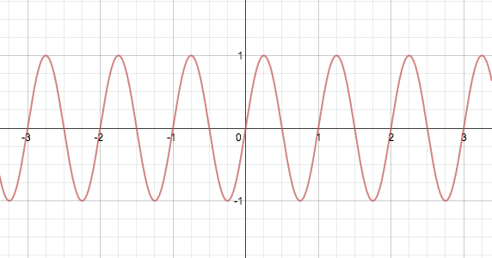
Waves and Vibrations
Angular Frequency
This graph shows a wave's dependency on frequency.
Free to share, print, make copies and changes. Get yours at www.boundless.com
Boundless. "Boundless." GNU FDL http://www.boundless.com/ View on Boundless.com

Slide 71
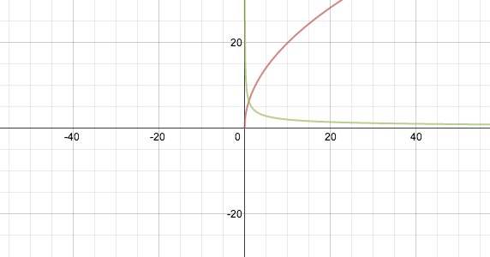
Waves and Vibrations
Interactive Graph: Period of Mass on a String
This image is the graphic representation of the period of a mass on a spring. The first graph shows how the period varies with mass and unchanging spring constant, while the second shows how period varies with changing spring constant and constant mass.
Free to share, print, make copies and changes. Get yours at www.boundless.com
Boundless. "Boundless." GNU FDL http://www.boundless.com/ View on Boundless.com

Slide 72
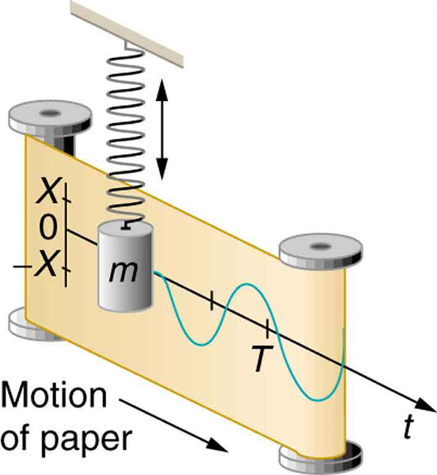
Waves and Vibrations
Mass on Spring Producing Sine Wave
The vertical position of an object bouncing on a spring is recorded on a strip of moving paper, leaving a sine wave.
Free to share, print, make copies and changes. Get yours at www.boundless.com
OpenStax CNX. "OpenStax College, College Physics. October 8, 2012." CC BY 3.0 http://cnx.org/content/m42242/latest/?collection=col11406/1.7 View on Boundless.com

Slide 73
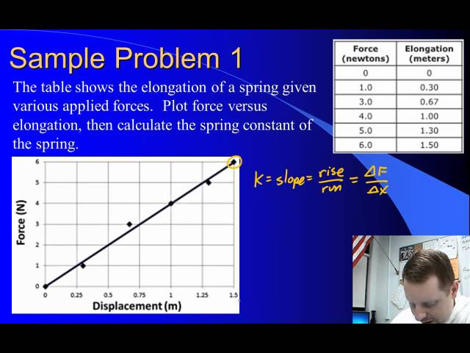
Waves and Vibrations
Springs and Hooke's Law
A brief overview of springs, Hooke's Law, and elastic potential energy for algebra-based physics students.
Free to share, print, make copies and changes. Get yours at www.boundless.com
View on Boundless.com

Slide 74
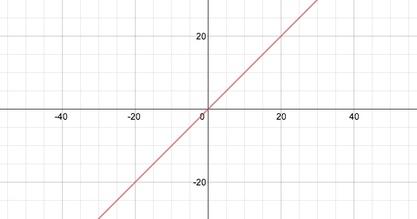
Waves and Vibrations
Hooke's Law
This graph illustrates how force, F, varies with position. You can change the spring constant, k, to see how the equation responds.
Free to share, print, make copies and changes. Get yours at www.boundless.com
Boundless. "Boundless." GNU FDL http://www.boundless.com/ View on Boundless.com

Slide 75
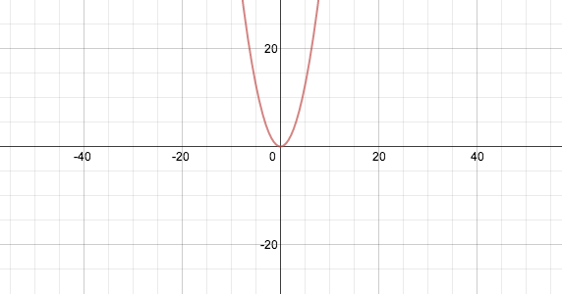
Waves and Vibrations
Elastic Potential Energy
A graphical representation of the equation for elastic potential energy. You can change the value of the spring constant, k, to see how the equation responds.
Free to share, print, make copies and changes. Get yours at www.boundless.com
Boundless. "Boundless." GNU FDL http://www.boundless.com/ View on Boundless.com

Slide 76
Waves and Vibrations
Frequencies of different sine waves.
The red wave has a low frequency sine there is very little repetition of cycles. Conversely we say that the purple wave has a high frequency. Note that time increases along the horizontal.
Free to share, print, make copies and changes. Get yours at www.boundless.com
Wikipedia. "Sine waves different frequencies." Public domain http://en.wikipedia.org/wiki/File:Sine_waves_different_frequencies.svg View on Boundless.com

Slide 77
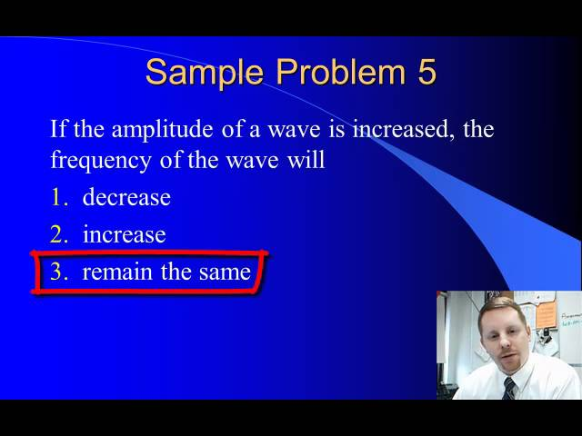
Waves and Vibrations
The Wave Equation
A brief introduction to the wave equation, discussing wave velocity, frequency, wavelength, and period.
Free to share, print, make copies and changes. Get yours at www.boundless.com
View on Boundless.com

Slide 78
Waves and Vibrations
Water waves
The motion water waves causes particles to follow clockwise circular motion. This is a result of the wave having both transverse and longitudinal properties.
Free to share, print, make copies and changes. Get yours at www.boundless.com
Wikipedia. "Elliptical trajectory on ripples." GNU FDL http://en.wikipedia.org/wiki/File:Elliptical_trajectory_on_ripples.svg View on Boundless.com

Slide 79
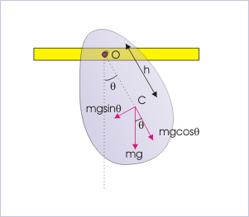
Waves and Vibrations
A Physical Pendulum
An example showing how forces act through center of mass. We can calculate the period of this pendulum by determining the moment of inertia of the object around the pivot point.
Free to share, print, make copies and changes. Get yours at www.boundless.com
OpenStax CNX. "Sunil Kumar Singh, Simple and Physical Pendulum. October 8, 2012." CC BY 3.0 http://cnx.org/content/m15585/latest/ View on Boundless.com

Slide 80
Waves and Vibrations
Pendulums - Physical Pendulum
A brief introduction to pendulums (both ideal and physical) for calculus-based physics students from the standpoint of simple harmonic motion.
Free to share, print, make copies and changes. Get yours at www.boundless.com
View on Boundless.com

Slide 81
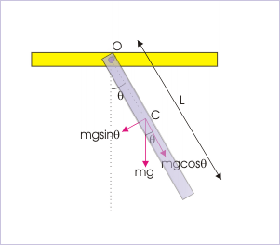
Waves and Vibrations
Uniform Rigid Rod
A rigid rod with uniform mass distribution hangs from a pivot point. This is another example of a physical pendulum.
Free to share, print, make copies and changes. Get yours at www.boundless.com
OpenStax CNX. "Sunil Kumar Singh, Simple and Physical Pendulum. October 8, 2012." CC BY 3.0 http://cnx.org/content/m15585/latest/ View on Boundless.com

Slide 82
Waves and Vibrations
Damped Harmonic Motion
Illustrating the position against time of our object moving in simple harmonic motion. We see that for small damping, the amplitude of our motion slowly decreases over time.
Free to share, print, make copies and changes. Get yours at www.boundless.com
OpenStax CNX. "OpenStax College, Damped Harmonic Motion. November 3, 2012." CC BY 3.0 http://cnx.org/content/m42246/latest/ View on Boundless.com

Slide 83
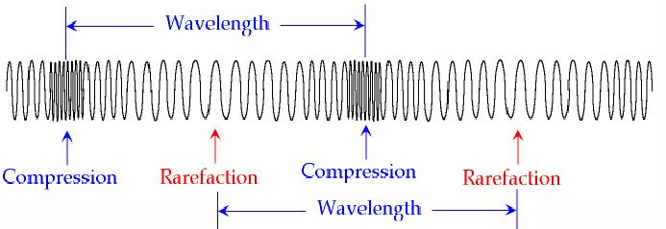
Waves and Vibrations
Longitudinal Waves
A compressed Slinky is an example of a longitudinal wave. The wave propagates in the same direction of oscillation.
Free to share, print, make copies and changes. Get yours at www.boundless.com
Wikispaces. "funwaves - 5.Longitudinal wave." CC BY-SA http://funwaves.wikispaces.com/5.+Longitudinal+wave View on Boundless.com

Slide 84
Waves and Vibrations
Two Types of Waves: Longitudinal vs. Transverse
Even ocean waves!
Free to share, print, make copies and changes. Get yours at www.boundless.com
View on Boundless.com

Slide 85
Attribution
Waves and Vibrations
Wikipedia. "wave speed." CC BY-SA 3.0 http://en.wikipedia.org/wiki/wave%20speed
Wiktionary. "frequency." CC BY-SA 3.0 http://en.wiktionary.org/wiki/frequency
Wiktionary. "wavelength." CC BY-SA 3.0 http://en.wiktionary.org/wiki/wavelength
Wikipedia. "Phase velocity." CC BY-SA 3.0 http://en.wikipedia.org/wiki/Phase_velocity
Wikipedia. "Group velocity." CC BY-SA 3.0 http://en.wikipedia.org/wiki/Group_velocity
Wikipedia. "Frequency." CC BY-SA 3.0 http://en.wikipedia.org/wiki/Frequency
Wikipedia. "Frequency." CC BY-SA 3.0 http://en.wikipedia.org/wiki/Frequency
Wikipedia. "Frequency." CC BY-SA 3.0 http://en.wikipedia.org/wiki/Frequency
Wikipedia. "Frequency." CC BY-SA 3.0 http://en.wikipedia.org/wiki/Frequency
Wiktionary. "force." CC BY-SA 3.0 http://en.wiktionary.org/wiki/force
Wiktionary. "equilibrium." CC BY-SA 3.0 http://en.wiktionary.org/wiki/equilibrium
Wiktionary. "oscillator." CC BY-SA 3.0 http://en.wiktionary.org/wiki/oscillator
Wikipedia. "Driven oscillations." CC BY-SA 3.0 http://en.wikipedia.org/wiki/Driven_oscillations%23Driven_harmonic_oscillators
Wiktionary. "medium." CC BY-SA 3.0 http://en.wiktionary.org/wiki/medium
Wikipedia. "direction of propagation." CC BY-SA 3.0 http://en.wikipedia.org/wiki/direction%20of%20propagation
Wiktionary. "wave." CC BY-SA 3.0 http://en.wiktionary.org/wiki/wave
Wikipedia. "Waves." CC BY-SA 3.0 http://en.wikipedia.org/wiki/Waves
Free to share, print, make copies and changes. Get yours at www.boundless.com

Slide 86
Waves and Vibrations
Wikipedia. "Waves." CC BY-SA 3.0 http://en.wikipedia.org/wiki/Waves
Wikipedia. "Wave." CC BY-SA 3.0 http://en.wikipedia.org/wiki/Wave
Wiktionary. "group velocity." CC BY-SA 3.0 http://en.wiktionary.org/wiki/group_velocity
Wiktionary. "phase velocity." CC BY-SA 3.0 http://en.wiktionary.org/wiki/phase_velocity
Wikipedia. "plane wave." CC BY-SA 3.0 http://en.wikipedia.org/wiki/plane%20wave
Wikipedia. "Wave power." CC BY-SA 3.0 http://en.wikipedia.org/wiki/Wave_power
Wikipedia. "Wave power." CC BY-SA 3.0 http://en.wikipedia.org/wiki/Wave_power
Wikipedia. "Wind wave." CC BY-SA 3.0 http://en.wikipedia.org/wiki/Wind_wave
Wikipedia. "Wave power." CC BY-SA 3.0 http://en.wikipedia.org/wiki/Wave_power
Wikipedia. "Wave power." CC BY-SA 3.0 http://en.wikipedia.org/wiki/Wave_power
Wikipedia. "Restoring force." CC BY-SA 3.0 http://en.wikipedia.org/wiki/Restoring%20force
Boundless Learning. "Boundless." CC BY-SA 3.0 http://www.boundless.com//biology/definition/ultrasound
Wikipedia. "photoelectric effects." CC BY-SA 3.0 http://en.wikipedia.org/wiki/photoelectric%20effects
OpenStax CNX. "OpenStax College, College Physics. September 17, 2013." CC BY 3.0 http://cnx.org/content/m42250/latest/?collection=col11406/1.7
Wikipedia. "mass distribution." CC BY-SA 3.0 http://en.wikipedia.org/wiki/mass%20distribution
Wikipedia. "physical pendulum." CC BY-SA 3.0 http://en.wikipedia.org/wiki/physical%20pendulum
Wikipedia. "Physical pendulum." CC BY-SA 3.0 http://en.wikipedia.org/wiki/Physical_pendulum%23Compound_pendulum
OpenStax CNX. "Sunil Kumar Singh, Simple and Physical Pendulum. September 17, 2013." CC BY 3.0 http://cnx.org/content/m15585/latest/
Wikipedia. "Fourier analysis." CC BY-SA 3.0 http://en.wikipedia.org/wiki/Fourier%20analysis
Free to share, print, make copies and changes. Get yours at www.boundless.com

Slide 87
Waves and Vibrations
Boundless Learning. "Boundless." CC BY-SA 3.0 http://www.boundless.com//physics/definition/waveform
Wikipedia. "Sinusoidal wave." CC BY-SA 3.0 http://en.wikipedia.org/wiki/Sinusoidal_wave
Wikipedia. "Wave equation." CC BY-SA 3.0 http://en.wikipedia.org/wiki/Wave_equation
Wikipedia. "Wave." CC BY-SA 3.0 http://en.wikipedia.org/wiki/Wave
Wiktionary. "sinusoidal." CC BY-SA 3.0 http://en.wiktionary.org/wiki/sinusoidal
OpenStax CNX. "OpenStax College, College Physics. September 17, 2013." CC BY 3.0 http://cnx.org/content/m42242/latest/?collection=col11406/1.7
Light and Matter. "Vibrations." CC BY-SA http://lightandmatter.com/html_books/me/ch16/ch16.html
Wikipedia. "Harmonic oscillator." CC BY-SA 3.0 http://en.wikipedia.org/wiki/Harmonic_oscillator
Wikipedia. "Simple harmonic motion." CC BY-SA 3.0 http://en.wikipedia.org/wiki/Simple_harmonic_motion
Wikipedia. "wave equation." CC BY-SA 3.0 http://en.wikipedia.org/wiki/wave%20equation
Wikipedia. "boundary condition." CC BY-SA 3.0 http://en.wikipedia.org/wiki/boundary%20condition
Wikipedia. "Wave equation." CC BY-SA 3.0 http://en.wikipedia.org/wiki/Wave_equation
Boundless Learning. "Boundless." CC BY-SA 3.0 http://www.boundless.com//physics/definition/critically-damped
Boundless Learning. "Boundless." CC BY-SA 3.0 http://www.boundless.com//physics/definition/over-damped
Boundless Learning. "Boundless." CC BY-SA 3.0 http://www.boundless.com//physics/definition/under-damped
Wikipedia. "angular frequency." CC BY-SA 3.0 http://en.wikipedia.org/wiki/angular%20frequency
Wiktionary. "frequency." CC BY-SA 3.0 http://en.wiktionary.org/wiki/frequency
Wikipedia. "period." CC BY-SA 3.0 http://en.wikipedia.org/wiki/period
Light and Matter. "Vibrations." CC BY-SA http://lightandmatter.com/html_books/me/ch16/ch16.html
Free to share, print, make copies and changes. Get yours at www.boundless.com

Slide 88
Waves and Vibrations
Wikipedia. "Period (physics)." CC BY-SA 3.0 http://en.wikipedia.org/wiki/Period_(physics)
Light and Matter. "Vibrations." CC BY-SA http://lightandmatter.com/html_books/me/ch16/ch16.html
Wiktionary. "rarefaction." CC BY-SA 3.0 http://en.wiktionary.org/wiki/rarefaction
Wiktionary. "compression." CC BY-SA 3.0 http://en.wiktionary.org/wiki/compression
Wiktionary. "Longitudinal." CC BY-SA 3.0 http://en.wiktionary.org/wiki/Longitudinal
Wikipedia. "Longitudinal wave." CC BY-SA 3.0 http://en.wikipedia.org/wiki/Longitudinal_wave
Wikipedia. "Sound waves." CC BY-SA 3.0 http://en.wikipedia.org/wiki/Sound_waves%23Longitudinal_and_transverse_waves
Wiktionary. "refractive index." CC BY-SA 3.0 http://en.wiktionary.org/wiki/refractive_index
Wikipedia. "Snell's law." CC BY-SA 3.0 http://en.wikipedia.org/wiki/Snell's%20law
Wikipedia. "Refraction." CC BY-SA 3.0 http://en.wikipedia.org/wiki/Refraction
Wiktionary. "elasticity." CC BY-SA 3.0 http://en.wiktionary.org/wiki/elasticity
OpenStax CNX. "Free High School Science Texts Project, Mechanical Properties of Matter: Deformation of Materials. September 17, 2013." CC BY 3.0 http://cnx.org/content/m39533/latest/
Wikipedia. "Hooke's law." CC BY-SA 3.0 http://en.wikipedia.org/wiki/Hooke's_law
Boundless Learning. "Boundless." CC BY-SA 3.0 http://www.boundless.com//physics/definition/uniform-circular-motion
Boundless Learning. "Boundless." CC BY-SA 3.0 http://www.boundless.com//physics/definition/centripetal-acceleration
Wikipedia. "Simple harmonic motion." CC BY-SA 3.0 http://en.wikipedia.org/wiki/Simple_harmonic_motion%23Uniform_circular_motion
Wikipedia. "Uniform circular motion." CC BY-SA 3.0 http://en.wikipedia.org/wiki/Uniform_circular_motion
OpenStax CNX. "OpenStax College, College Physics. September 17, 2013." CC BY 3.0 http://cnx.org/content/m42245/latest/?collection=col11406/1.7
Wiktionary. "oscillating." CC BY-SA 3.0 http://en.wiktionary.org/wiki/oscillating
Free to share, print, make copies and changes. Get yours at www.boundless.com

Slide 89
Waves and Vibrations
Wikipedia. "kinetic energy." CC BY-SA 3.0 http://en.wikipedia.org/wiki/kinetic%20energy
Wiktionary. "deformation." CC BY-SA 3.0 http://en.wiktionary.org/wiki/deformation
Wikipedia. "Elastic potential energy." CC BY-SA 3.0 http://en.wikipedia.org/wiki/Elastic_potential_energy
Wikipedia. "Elastic potential energy." CC BY-SA 3.0 http://en.wikipedia.org/wiki/Elastic_potential_energy
Wikipedia. "Elastic potential energy." CC BY-SA 3.0 http://en.wikipedia.org/wiki/Elastic_potential_energy
OpenStax CNX. "OpenStax College, College Physics. September 17, 2013." CC BY 3.0 http://cnx.org/content/m42240/latest/?collection=col11406/1.7
Boundless Learning. "Boundless." CC BY-SA 3.0 http://www.boundless.com//sociology/definition/power
Wiktionary. "work." CC BY-SA 3.0 http://en.wiktionary.org/wiki/work
Wiktionary. "energy." CC BY-SA 3.0 http://en.wiktionary.org/wiki/energy
Wikipedia. "Electromagnetic radiation." CC BY-SA 3.0 http://en.wikipedia.org/wiki/Electromagnetic_radiation
Wikipedia. "Electromagnetic radiation." CC BY-SA 3.0 http://en.wikipedia.org/wiki/Electromagnetic_radiation
Wiktionary. "simple harmonic motion." CC BY-SA 3.0 http://en.wiktionary.org/wiki/simple_harmonic_motion
OpenStax CNX. "Sunil Kumar Singh, Transverse Harmonic Waves. September 17, 2013." CC BY 3.0 http://cnx.org/content/m15992/latest/
Wiktionary. "standing wave." CC BY-SA 3.0 http://en.wiktionary.org/wiki/standing_wave
Wiktionary. "transverse wave." CC BY-SA 3.0 http://en.wiktionary.org/wiki/transverse_wave
Wiktionary. "amplitude." CC BY-SA 3.0 http://en.wiktionary.org/wiki/amplitude
OpenStax CNX. "Rory Adams (Free High School Science Texts Project), Mark Horner, and Heather Williams, Transverse Waves - Grade 10. September 17, 2013." CC BY 3.0 http://cnx.org/content/m32635/latest/
Wikipedia. "boundary condition." CC BY-SA 3.0 http://en.wikipedia.org/wiki/boundary%20condition
OpenStax CNX. "Paul Padley, Reflection and Transmission of Mechanical Waves. September 17, 2013." CC BY 3.0 http://cnx.org/content/m12794/latest/
Free to share, print, make copies and changes. Get yours at www.boundless.com

Slide 90
Waves and Vibrations
Wiktionary. "interference." CC BY-SA 3.0 http://en.wiktionary.org/wiki/interference
Boundless Learning. "Boundless." CC BY-SA 3.0 http://www.boundless.com//physics/definition/superposition
OpenStax CNX. "OpenStax College, Superposition and Interference. September 17, 2013." CC BY 3.0 http://cnx.org/content/m42249/latest/
Boundless Learning. "Boundless." CC BY-SA 3.0 http://www.boundless.com//physics/definition/destructive-interference
Boundless Learning. "Boundless." CC BY-SA 3.0 http://www.boundless.com//physics/definition/constructive-interference
Wiktionary. "resonance." CC BY-SA 3.0 http://en.wiktionary.org/wiki/resonance
OpenStax CNX. "OpenStax College, Superposition and Interference. September 17, 2013." CC BY 3.0 http://cnx.org/content/m42249/latest/
Wiktionary. "transverse wave." CC BY-SA 3.0 http://en.wiktionary.org/wiki/transverse_wave
Wiktionary. "trough." CC BY-SA 3.0 http://en.wiktionary.org/wiki/trough
Wiktionary. "wavelength." CC BY-SA 3.0 http://en.wiktionary.org/wiki/wavelength
Boundless Learning. "Boundless." CC BY-SA 3.0 http://www.boundless.com//physics/definition/speed-of-propagation
Wikipedia. "direction of propagation." CC BY-SA 3.0 http://en.wikipedia.org/wiki/direction%20of%20propagation
Wikipedia. "Transverse wave." CC BY-SA 3.0 http://en.wikipedia.org/wiki/Transverse_wave
Wikipedia. "Transverse wave." CC BY-SA 3.0 http://en.wikipedia.org/wiki/Transverse_wave
Wikipedia. "Transverse wave." CC BY-SA 3.0 http://en.wikipedia.org/wiki/Transverse_wave
Wiktionary. "crest." CC BY-SA 3.0 http://en.wiktionary.org/wiki/crest
Wiktionary. "interference." CC BY-SA 3.0 http://en.wiktionary.org/wiki/interference
Boundless Learning. "Boundless." CC BY-SA 3.0 http://www.boundless.com//physics/definition/superposition
Wikipedia. "Diffraction." CC BY-SA 3.0 http://en.wikipedia.org/wiki/Diffraction
Free to share, print, make copies and changes. Get yours at www.boundless.com

Slide 91
Waves and Vibrations
Boundless Learning. "Boundless." CC BY-SA 3.0 http://www.boundless.com//physics/definition/dissipative-forces
Boundless Learning. "Boundless." CC BY-SA 3.0 http://www.boundless.com//physics/definition/elastic-potential-energy
Wikipedia. "Simple harmonic motion." CC BY-SA 3.0 http://en.wikipedia.org/wiki/Simple_harmonic_motion
OpenStax CNX. "OpenStax College, College Physics. September 17, 2013." CC BY 3.0 http://cnx.org/content/m42244/latest/?collection=col11406/1.7
OpenStax CNX. "OpenStax College, College Physics. September 17, 2013." CC BY 3.0 http://cnx.org/content/m42240/latest/?collection=col11406/1.7
Wiktionary. "oscillator." CC BY-SA 3.0 http://en.wiktionary.org/wiki/oscillator
Wiktionary. "simple harmonic oscillator." CC BY-SA 3.0 http://en.wiktionary.org/wiki/simple+harmonic+oscillator
OpenStax CNX. "OpenStax College, College Physics. September 17, 2013." CC BY 3.0 http://cnx.org/content/m42242/latest/?collection=col11406/1.7
Wikipedia. "Simple harmonic motion." CC BY-SA 3.0 http://en.wikipedia.org/wiki/Simple_harmonic_motion%23Mass_on_a_spring
Wiktionary. "simple pendulum." CC BY-SA 3.0 http://en.wiktionary.org/wiki/simple_pendulum
OpenStax CNX. "OpenStax College, College Physics. September 17, 2013." CC BY 3.0 http://cnx.org/content/m42243/latest/?collection=col11406/1.7
Wikipedia. "Simple pendulum." CC BY-SA 3.0 http://en.wikipedia.org/wiki/Simple_pendulum
Wiktionary. "amplitude." CC BY-SA 3.0 http://en.wiktionary.org/wiki/amplitude
Wikipedia. "Restoring force." CC BY-SA 3.0 http://en.wikipedia.org/wiki/Restoring%20force
Wikipedia. "Simple harmonic motion." CC BY-SA 3.0 http://en.wikipedia.org/wiki/Simple_harmonic_motion%23Mass_on_a_spring
Light and Matter. "Vibrations." CC BY-SA http://lightandmatter.com/html_books/me/ch16/ch16.html
OpenStax CNX. "OpenStax College, College Physics. September 18, 2013." CC BY 3.0 http://cnx.org/content/m42240/latest/?collection=col11406/1.7
OpenStax CNX. "OpenStax College, College Physics. September 18, 2013." CC BY 3.0 http://cnx.org/content/m42242/latest/?collection=col11406/1.7
Wiktionary. "transverse wave." CC BY-SA 3.0 http://en.wiktionary.org/wiki/transverse_wave
Free to share, print, make copies and changes. Get yours at www.boundless.com

Slide 92
Waves and Vibrations
Wiktionary. "oscillate." CC BY-SA 3.0 http://en.wiktionary.org/wiki/oscillate
Wikipedia. "Wave." CC BY-SA 3.0 http://en.wikipedia.org/wiki/Wave%23Waves_on_strings
Wikipedia. "Vibrating string." CC BY-SA 3.0 http://en.wikipedia.org/wiki/Vibrating_string
OpenStax CNX. "Rory Adams (Free High School Science Texts Project), Mark Horner, and Heather Williams, Transverse Waves - Grade 10. September 18, 2013." CC BY 3.0 http://cnx.org/content/m32635/latest/
Free to share, print, make copies and changes. Get yours at www.boundless.com

